Slide 1
Math Department Resource Scheduling
Matthew Mooney
Brandon Rozzi
Trevor Smith

Slide 2
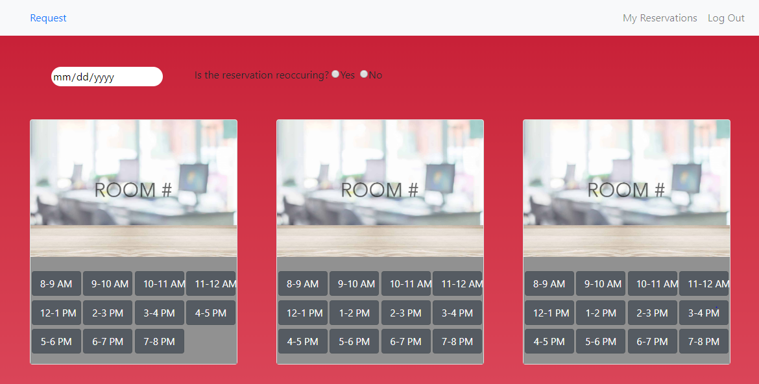
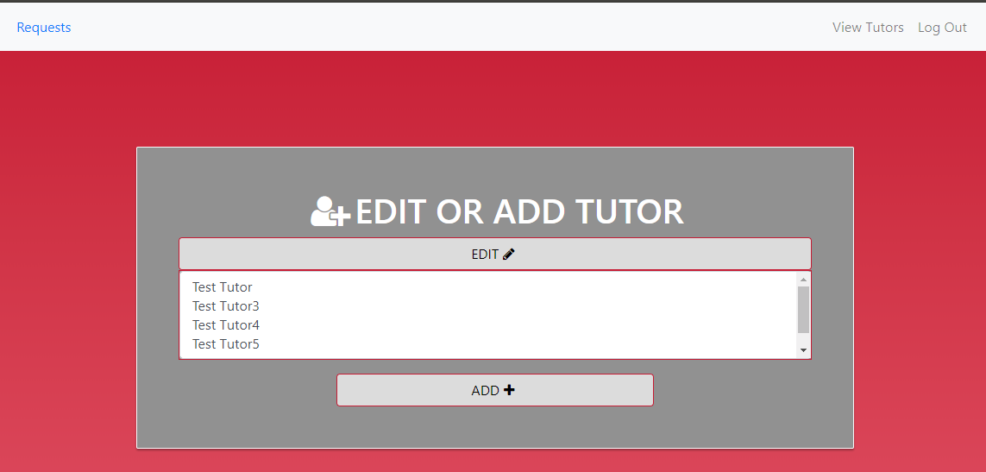
What is it?
A system for requesting Math Department rooms
A system to aid in the process of scheduling MAC tutors
Stores tutor availability and classes
Provides a suggested schedule using a sophisticated algorithm

Slide 3
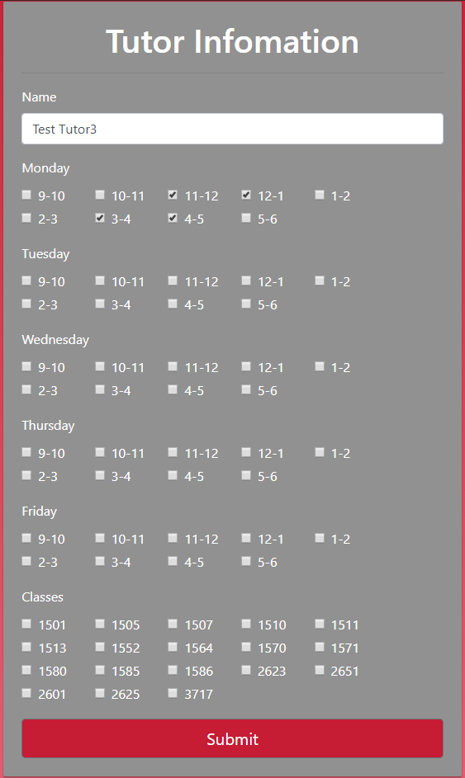
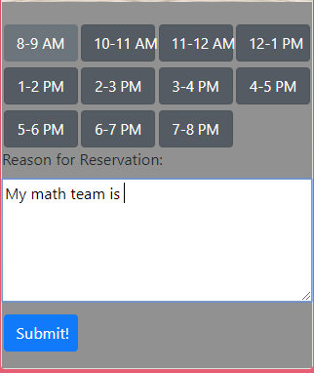
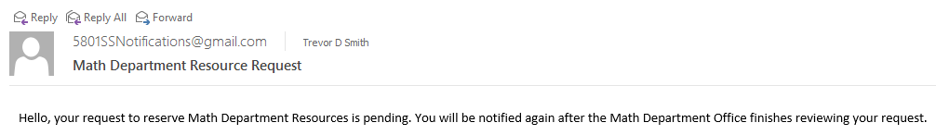
Who is it for?
The room scheduling system will be available for Math department faculty as well as outside faculty and students.
Request from outside faculty and students require approval from the office
Currently the Math department uses binders in the office to manage reservations
The tutor scheduling system is available to the MAC admin only
Currently the MAC has tutor availability stored across several spreadsheets

Slide 4
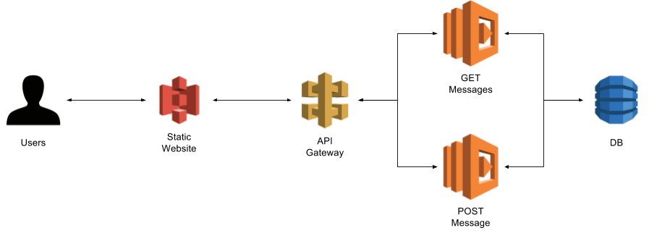
Cloud services used
AWS s3 – Simple Storage Service – Hosting the web content
AWS Lambda – Serverless compute service
AWS API Gateway – REST API that triggers lambda
AWS DynamoDB – NoSQL Database service – Storing Data
AWS Cognito – User Management
AWS SES – Simple Email Service – Sending notifications

Slide 5
Coming Features
Admin Approval
View Reservations
Suggested Schedule
Room Scheduling Stats

